Slide 1


Self Introduction

Slide 2




Recommendation System & App
Jason Zhang

Slide 3




Objective
Create a Recommendation System App for AirBnb Users
Helps the users to find listings they want quickly
Provide summarized reviews for each listing

Slide 4



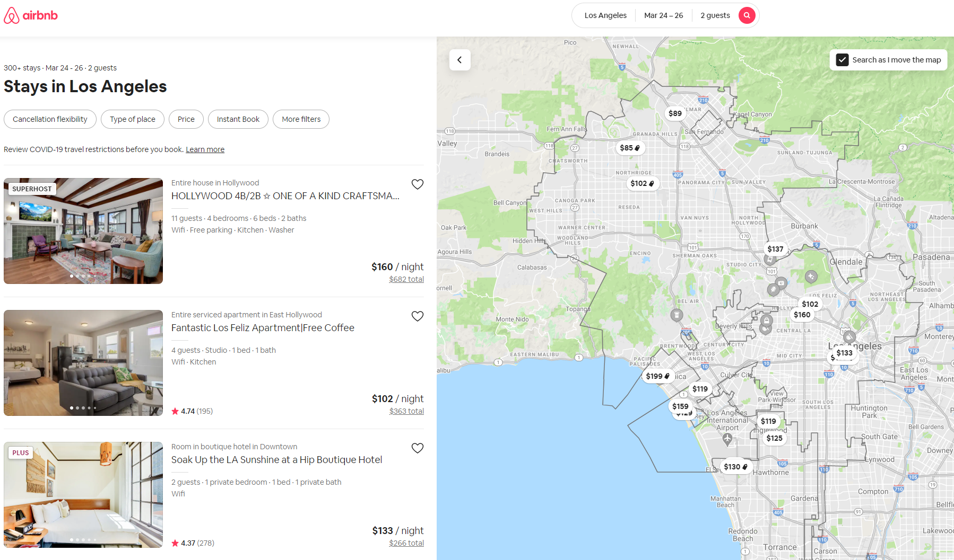
Sample of Airbnb Website

Slide 5
Current Issues Observed
Issue #1:
Listing Selection:
Large Volume
Strong Filtering Need
Time Consuming

Slide 6
Current Issues Observed
Issue #2:
Review Reading:
Large Volume
Read Mannelly
Time Consuming

Slide 7
Current Issues Observed
Issue #3:
Area Details:
No Description (Safety & Convenience)
Additional Research Need
Time Consuming

Slide 8


About the Data
Source: Airbnb Open Data
Features:
Listing’s General Information:
Airbnb Name
Description
Price Details
Location
Reviews Detail:
Reviewer’s Name
Comments
Review Date
Range: Sep 2015 - Sep 2016

Slide 9








Method
Data Cleaning & EDA
Preprocessing & NLP
Modeling & Application
Numpy
Punctuations
NMF Topic Modeling
Pandas
Stop-words
Content-Based Filtering
Seaborn
Stemming
TF-IDF Vectorizer
Streamlit

Slide 10
Topic Modeling
01
floor, private, queen, size, living, large, tv, guest
Family House
02
pike, place, market, view, condo, center, block, convention
Tourism & Events
03
minute, lake, park, house, ballard, quiet, block, close
Peaceful Vacation
04
apartment, hill, capitol, studio, building, heart, bar, cozy
Young Life Style
05
work, share, people, listing, tech, hacker, scene, house
Specialty Needs

Slide 11


Application Demo

Slide 12









Future Work
Data Expansion
Fine Tuning Model
Application Design
Additional Filters
Visualization
Include more locations
Build real-time data stream
NLP Tuning
Collaborative Filtering

Slide 13
Thank you!
Questions?
Contact: Jason.lw.Zhang@gmail.com

Slide 14
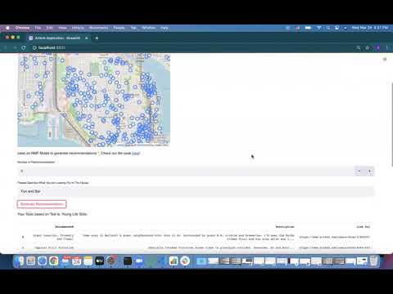
Appendix 1: Application Demo

Slide 15
Appendix 2: Data Source
AirBnb Open Data: http://insideairbnb.com/get-the-data.html

Slide 16





Appendix 3
House Renting Service
Founded in 2007
Advantages
International
Online Marketplace for home sharing
Originally called "Air Bed and Breakfast"
Wide Selections
Covers over 100,000 cities & 200 countries
Affordable Price

